Slide 1

Dynamic Activity Predictions Using Graph-based Neural Networks for Time Series Forecasting
Bhuvan Chennoju,
MS in Computer Science Candidate
School of Science and Engineering.,
University of Missouri – Kansas City.

Slide 2
Acknowledgement
Advisor
Dr. Yugyung Lee
Committee Members
Dr. Sejun Song
Dr. Reza Derakhshani

Slide 3

Agenda
1. Introduction
Background
Challenges and Contributions
2. Literature Review and Previous Work
Why TGCN?
Model Framework
Nature of Graph
3. Software and Hardware Stack and Tools
4. Proposed Approaches and Results
Graph Data Preparation and Tableau Visualizations
Validation of Framework on Benchmark Datasets
Attention Based Temporal Graph Convolutional Network Node Level Predictions
Statistical Methods & Machine Learning Model-based Time Series Predictions
Comparison of A3TGCN and Other Methods
5. Conclusions and Future Work

Slide 4
Introduction

Slide 5

Background
The ability to accurately forecast and model time series data is crucial for various disciplines, ranging from finance to climate science. [R. Adhikari and R. K. Agrawal,2013]
Traditional Time series forecasting is inefficient for complex spatial and temporal dependency patterns such as traffic flow forecasting, Energy Demand forecasting, Social Economic Studies, and Disease Spreading Patterns. [B. Yu, H. Yin, and Z. Zhu, 2017]
Traditional Time Series are either Model is driven or Data Driven, and alternative to consider interdependencies.
Graph Convolutional Networks have been widely applied in various domains when traditional forecasting methods become obsolete.
R. Adhikari and R. K. Agrawal, “An introductory study on time series modeling and forecasting,” ArXiv Preprint arXiv:1302.6613, 2013.
B. Yu, H. Yin, and Z. Zhu, “Spatio-temporal graph convolutional networks: A deep learning framework for traffic forecasting,” ArXiv Preprint arXiv:1709.04875, 2017.

Slide 6
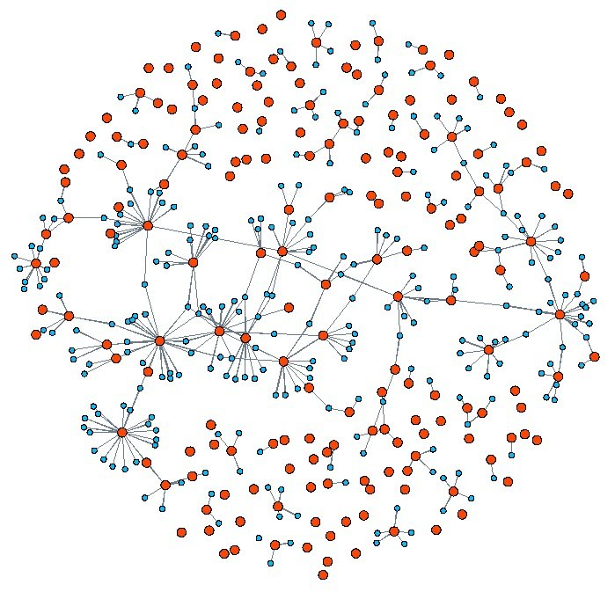
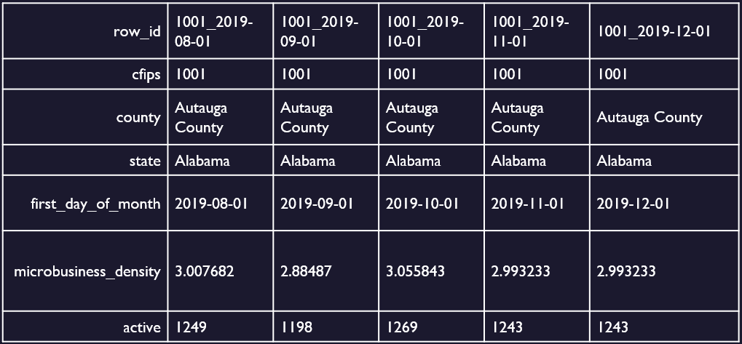
Challenges and Contributions
Raw Tabular Data to Graph Data Conversion
Graphs are highly complex structures that need edges and nodes.
Nodes and Edges establishment is tricky without proper assumptions.
Contributions:
A few ways were explored to create the graph and made assumptions to convert the tabular data to graph data.

Slide 7
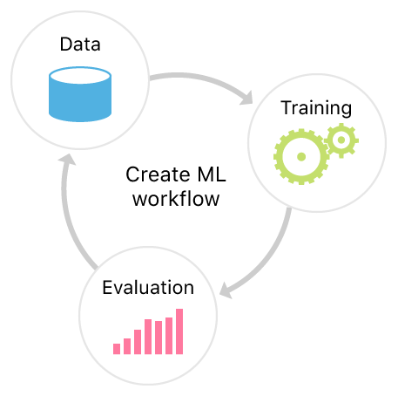
Challenges and Contributions
Benchmarking, Model Training, and Evaluation:
Benchmarking is a big challenge as the dataset is new and unknown.
Model Training heavily depends on the quality of the time signal in graph format.
Evaluation metric Choosing and evaluating the model is critical.

Slide 8
Challenges and Contributions (cont.)
Contributions:
Few baseline establishments and benchmarking methods were explored based on traditional time series forecasting.
Temporal Graph Data was converted to Temporal Signal with graph information and the feature space for practical training.
Evaluation metrics were decided based on the sensitivity to prediction errors.

Slide 9
Agenda
1. Introduction
Background
Challenges and Contributions
2. Literature Review and Previous Work
Why TGCN?
Model Framework
Nature of Graph
3. Software and Hardware Stack and Tools
4. Proposed Approaches and Results
Graph Data Preparation and Tableau Visualizations
Validation of Framework on Benchmark Datasets
Attention Based Temporal Graph Convolutional Network Node Level predictions
Statistical Methods & Machine Learning Model-based Time Series Predictions
Comparison of A3TGCN and Other Methods
4. Conclusions and Future Work

Slide 10
Literature Review and Related Work

Slide 11
Why Temporal Graph Convolutional Networks?
Traffic forecasting, Energy Demand forecasting, and Pandemic Spread forecasting are a few applications where forecasting has always been challenging due to its complex spatial and temporal dependences.
Spatial Dependence: dominated by the topological structures
Temporal dependence: dynamic over time, mainly reflected in periodicity and trend.
Traditional forecasting methods such as Autoregressive Integrated Moving Average (ARIMA) model, SVMs, KNNs, and others capture temporal dependence while ignoring spatial dependence. [J. Zhu et al., 2020]
Fig. Assuming that node 1 is a central road. (a) The blue nodes
indicate the roads connected to the central road. (b) We obtain the
spatial feature by obtaining the topological relationship between road 1 and the surrounding roads.
J. Zhu, Y. Song, L. Zhao, and H. Li, “A3t-gcn: Attention temporal graph convolutional network for traffic forecasting,” 2020.

Slide 12
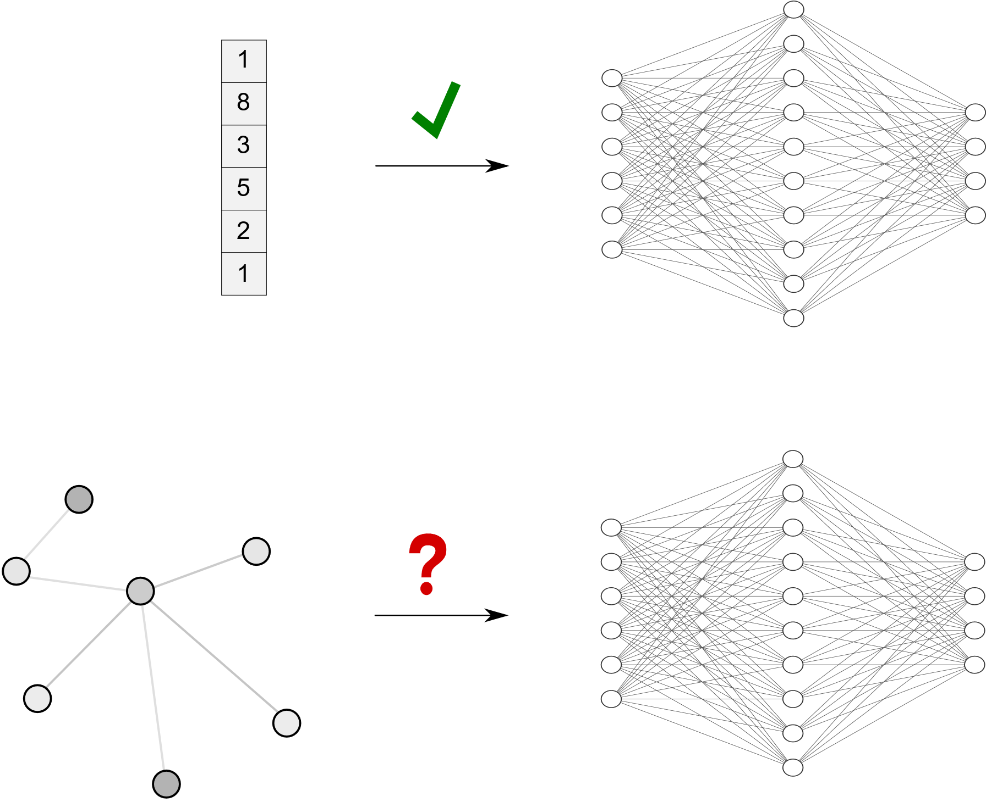
Why Temporal Graph Convolutional Networks? (cont.)
Later CNNs were introduced for spatial modeling, But they cannot work with complex irregular spatial patterns to capture spatial dependence.
Graph Convolutional Networks are effective in handling such spatial dependence. Temporal Graph Convolutional Networks were introduced to capture both spatial and temporal dependence.
Temporal Graph Networks(TGNs) operating on continuous time dynamic graphs represented as events.
Predictions could be Node Level, Edge Level

Slide 13
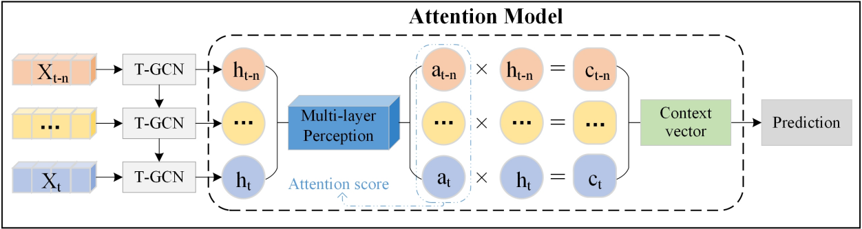
Model Framework
Attention-Based Temporal Graph Convolutional Network: [J. Zhu et al., 2020]
GRU captures the dynamic variation of node attributes to obtain the Local temporal tendency of the Network
Where the Attention model captures the global variation trend of the Network to predict the future Network State accurately.
A scoring function is designed to calculate the weight of each hidden state.
The hidden states are calculated in CNN
An attention function is designed to calculate the context vector (Ct) that describes global parameter variation information.
Soft attention models involve three main steps:
Attention Based Temporal Graph Convolutional Network Framework
Attention Based Temporal Graph Convolutional Network Framework
J. Zhu, Y. Song, L. Zhao, and H. Li, “A3t-gcn: Attention temporal graph convolutional network for traffic forecasting,” 2020.

Slide 14
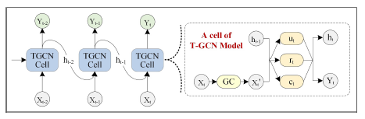
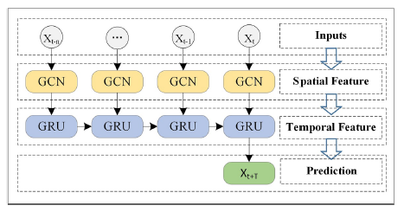
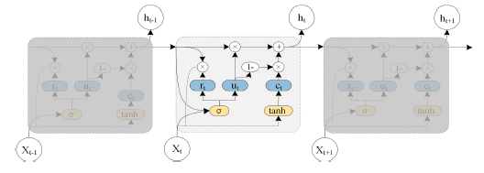
Model Framework (cont.)
Temporal Graph Convolutional Network:
Graph Convolutional Network – Capture the topological structure of the graph networks to obtain the spatial feature.
Gated Recurrent Unit – Spatial features are input into Gru, capture the temporal features, and result through the fully connected layer.
The overall process of spatio - temporal prediction. The right part
represents the specific architecture of a T-GCN unit, and GC represents graph convolution.
Temporal Graph Convolutional Network Framework
The architecture of the Gated Recurrent Unit model.

Slide 15
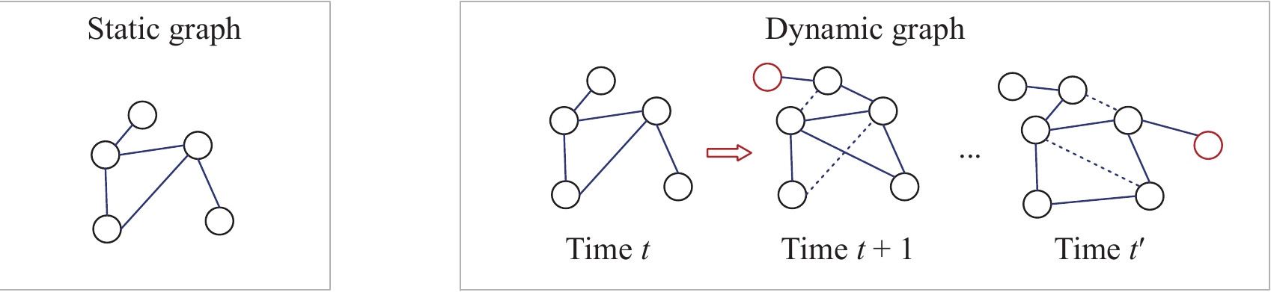
Nature of Graph
Static Graph: A static graph is a graph where the nodes and connections are defined once, and the graph remains fixed during training and inference.
Dynamic Graph: A dynamic graph is a graph where the nodes and connections can change during the computation.

Slide 16
Agenda
1. Introduction
Background
Challenges and Contributions
2. Literature Review and Previous Work
Why TGCN?
Model Framework
Nature of Graph
3. Software and Hardware Stack and Tools
4. Proposed Approaches and Results
Graph Data Preparation and Tableau Visualizations
Validation of Framework on Benchmark Datasets
Attention Based Temporal Graph Convolutional Network Node level predictions
Statistical Methods & Machine learning Model-based Time series predictions
Comparison of A3TGCN and Other Methods
4. Conclusions and Future Work

Slide 17
Software, Hardware Stack, and Tools

Slide 18







Software, Hardware Stack and Tools
Software Stack:
Python Programming Language
PyTorch Deep Learning Framework
PyTorch Geometric Temporal for Temporal Graph Operations and Network Training
NetworkX library for Graph Construction
Tableau Public Software for Dashboarding and Reporting.
Pandas and Numpy for data manipulation and processing.

Slide 19
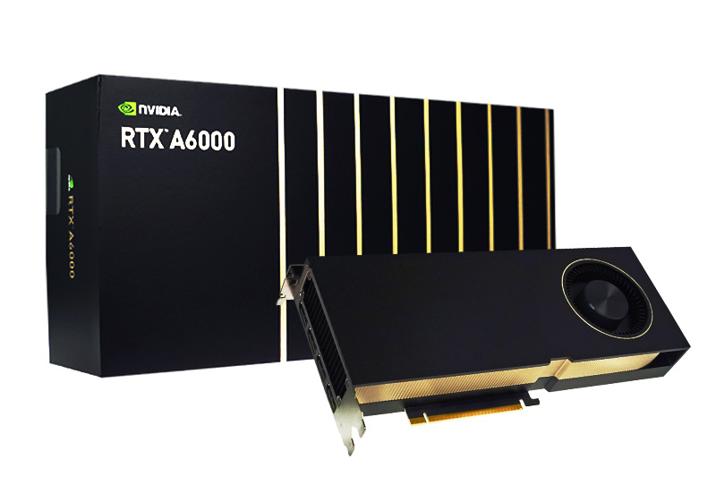
Software, Hardware Stack and Tools
Hardware Stack:
CPU: 2xAMD EPYC 7H12 (128 cores total)
RAM: 512GB
GPU: 8xNvidia RTX A6000 with 48GB of RAM each
Scratch: 3.5TB of local scratch space for temporary files.

Slide 20
Agenda
1. Introduction
Background
Challenges and Contributions
2. Literature Review and Previous Work
Why TGCN?
Model Framework
Nature of Graph
3. Software and Hardware Stack and Tools
4. Proposed Approaches and Results
Graph Data Preparation and Tableau Visualizations
Validation of Framework on Benchmark Datasets
Attention Based Temporal Graph Convolutional Network Node level predictions
Statistical Methods & Machine learning Model-based Time series predictions
Comparison of A3TGCN and Other Methods
4. Conclusions and Future Work

Slide 21
Proposed Approaches and Results

Slide 22
Graph Data Preparation and Tableau Visualizations
Dataset:
United States Microbusiness Density data from GoDaddy.com Survey [1]
Frequency of Data Collection - Monthly
39 Months of data for 51 States and 3135 Individual Counties.
Yearly county-level census Data from 2017 – 2022
What is Microbusiness Density? Microbusiness Density measures the number of micro-businesses per resident aged 18 and older. Higher microbusiness density is associated with a range of economic benefits.

Slide 23
Graph Data Preparation and Tableau Visualizations
0 | 1 | 2 | 3 | 4
pct_bb_2017 | 76.6 | 74.5 | 57.2 | 62.0 | 65.8
pct_bb_2018 | 78.9 | 78.1 | 60.4 | 66.1 | 68.5
pct_bb_2019 | 80.6 | 81.8 | 60.5 | 69.2 | 73.0
pct_bb_2020 | 82.7 | 85.1 | 64.6 | 76.1 | 79.6
pct_bb_2021 | 85.5 | 87.9 | 64.6 | 74.6 | 81.0
cfips | 1001.0 | 1003.0 | 1005.0 | 1007.0 | 1009.0
pct_college_2017 | 14.5 | 20.4 | 7.6 | 8.1 | 8.7
pct_college_2018 | 15.9 | 20.7 | 7.8 | 7.6 | 8.1
pct_college_2019 | 16.1 | 21.0 | 7.6 | 6.5 | 8.6
pct_college_2020 | 16.7 | 20.2 | 7.3 | 7.4 | 8.9
pct_college_2021 | 16.4 | 20.6 | 6.7 | 7.9 | 9.3
pct_foreign_born_2017 | 2.1 | 3.2 | 2.7 | 1.0 | 4.5
pct_foreign_born_2018 | 2.0 | 3.4 | 2.5 | 1.4 | 4.4
pct_foreign_born_2019 | 2.3 | 3.7 | 2.7 | 1.5 | 4.5
pct_foreign_born_2020 | 2.3 | 3.4 | 2.6 | 1.6 | 4.4
pct_foreign_born_2021 | 2.1 | 3.5 | 2.6 | 1.1 | 4.5
pct_it_workers_2017 | 1.3 | 1.4 | 0.5 | 1.2 | 1.3
pct_it_workers_2018 | 1.1 | 1.3 | 0.3 | 1.4 | 1.4
pct_it_workers_2019 | 0.7 | 1.4 | 0.8 | 1.6 | 0.9
pct_it_workers_2020 | 0.6 | 1.0 | 1.1 | 1.7 | 1.1
pct_it_workers_2021 | 1.1 | 1.3 | 0.8 | 2.1 | 0.9
median_hh_inc_2017 | 55317.0 | 52562.0 | 33368.0 | 43404.0 | 47412.0
median_hh_inc_2018 | 58786.0 | 55962.0 | 34186.0 | 45340.0 | 48695.0
median_hh_inc_2019 | 58731.0 | 58320.0 | 32525.0 | 47542.0 | 49358.0
median_hh_inc_2020 | 57982.0 | 61756.0 | 34990.0 | 51721.0 | 48922.0
median_hh_inc_2021 | 62660.0 | 64346.0 | 36422.0 | 54277.0 | 52830.0
Dataset: (cont.)
row_id | 1001_2019-08-01 | 1001_2019-09-01 | 1001_2019-10-01 | 1001_2019-11-01 | 1001_2019-12-01
cfips | 1001 | 1001 | 1001 | 1001 | 1001
county | Autauga County | Autauga County | Autauga County | Autauga County | Autauga County
state | Alabama | Alabama | Alabama | Alabama | Alabama
first_day_of_month | 2019-08-01 | 2019-09-01 | 2019-10-01 | 2019-11-01 | 2019-12-01
microbusiness_density | 3.007682 | 2.88487 | 3.055843 | 2.993233 | 2.993233
active | 1249 | 1198 | 1269 | 1243 | 1243
US Microbusiness Density Dataset
US Census Dataset

Slide 24
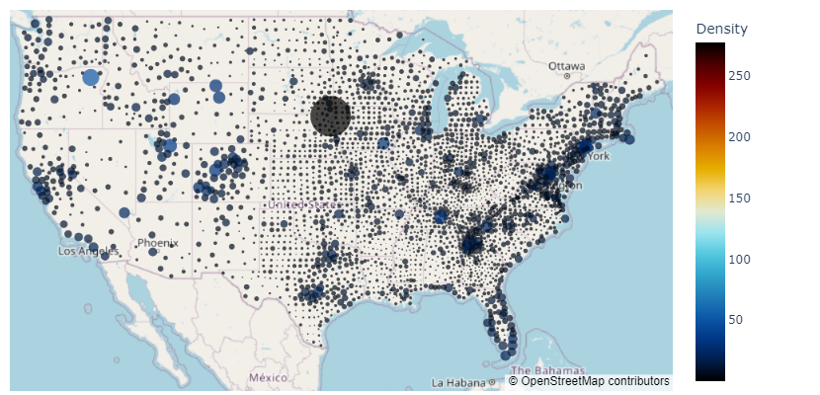
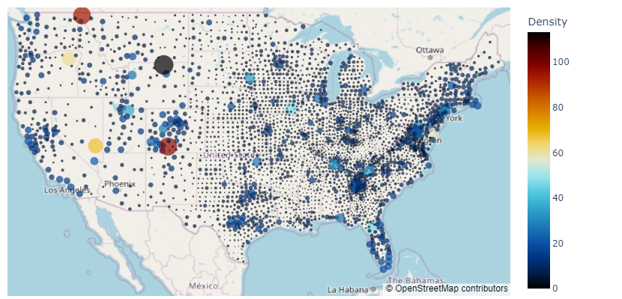
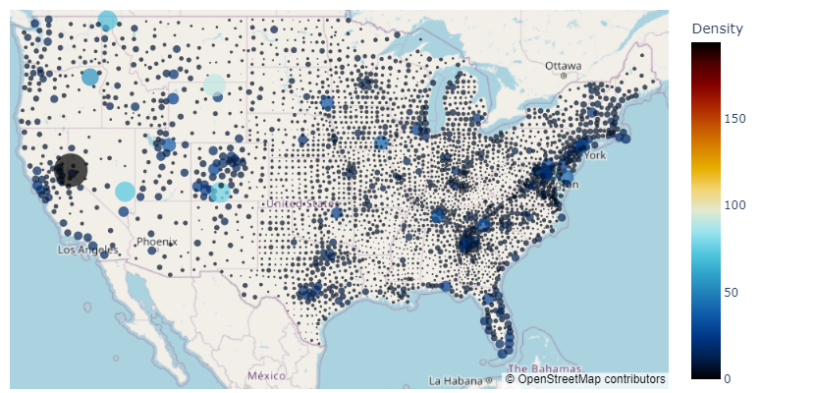
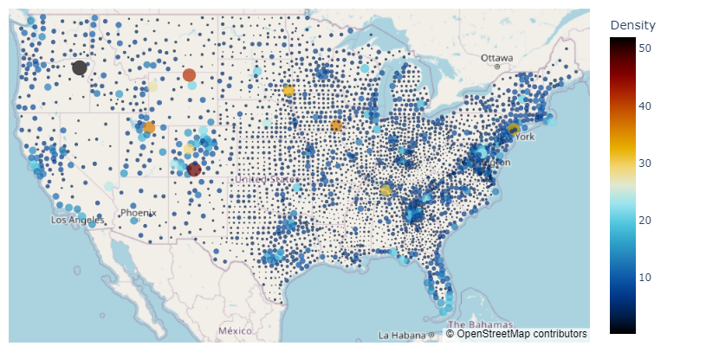
Data on Map
(a) Microbusiness Density Distribution on
2019-08-01
(b) Microbusiness Density Distribution on
2019-09-01
(c) Microbusiness Density Distribution on
2019-10-01
(d) Microbusiness Density Distribution on
2019-11-01

Slide 25
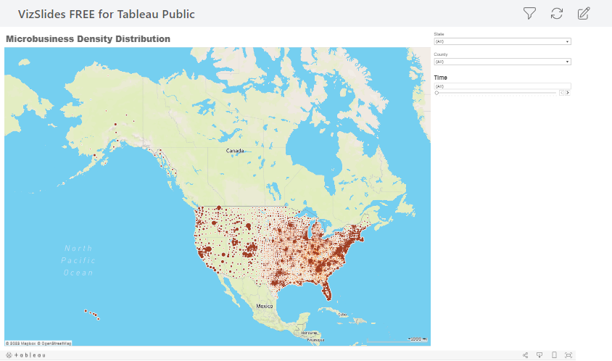
Graph Data Preparation and Tableau Visualizations
Tableau Dashboard

Slide 26
Graph Data Preparation and Tableau Visualizations
Tabular Data to Graph Data:
Node-level Prediction problem needs graph snapshots based on a sequence of events.
Challenges:
Graph Construction:
1. What are nodes? How to create the edge?
2. Nodes could be at any level – A level of Detail conundrum
3. Edge links are the relationships between the nodes. – Edge Approximations
Graph Nature: Static and Dynamic
Graph Feature Embeddings:
1. Node Features: The node’s unique features change with time and constant.
2. Edge Features: These are unique features that capture the relationships, weights of the relationships, or directionality of the link.

Slide 27
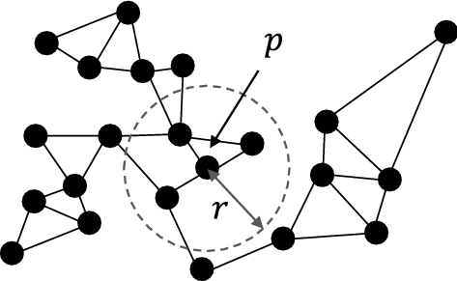
Graph Data Preparation and Tableau Visualizations
Tabular Data to Graph Data: (cont.)
Solutions:
Graph Construction:
1. Counties in the graph were decided to form Node with equal importance.
2. Edge links are formed based on the circle of the distance threshold. The clustering technique was explored, but the distance threshold yielded logical graphs.
Graph Nature:
Dynamic Graphs are construed by randomly dropping 25% of total edge links with distance threshold.

Slide 28
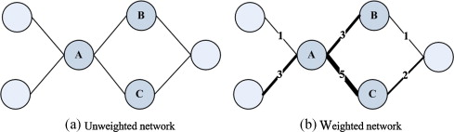
Graph Data Preparation and Tableau Visualizations
Tabular Data to Graph Data: (cont.)
Solutions:
Graph Feature Embeddings:
1. Node Features:
i. Dynamic Features: County-level Microbusiness density values from t(n-L) are used, where n is the nth time snapshot and L – is the lag period.
ii. Static Features: County-level census data values are used.
2. Edge Features: The Distance thresholds are used as the edge features and edge weights. Graph directionality at edges is treated as Undirected graphs.

Slide 29
Graph Data Preparation and Tableau Visualizations
Structured Data → Graph Network Data for Node–level Prediction
Node → County
Node Features: Temporal (lags) + Census Data
Edge → Distance Between Counties
Edge Feature: Distance in miles
Tabular Data to Graph Data: (cont.)
Summary

Slide 30
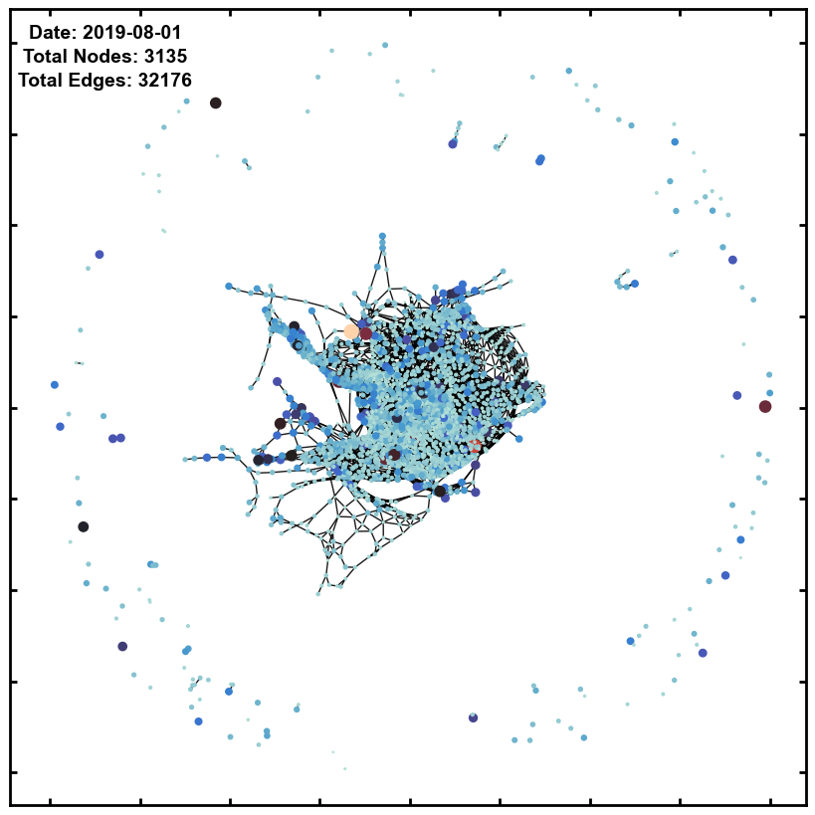
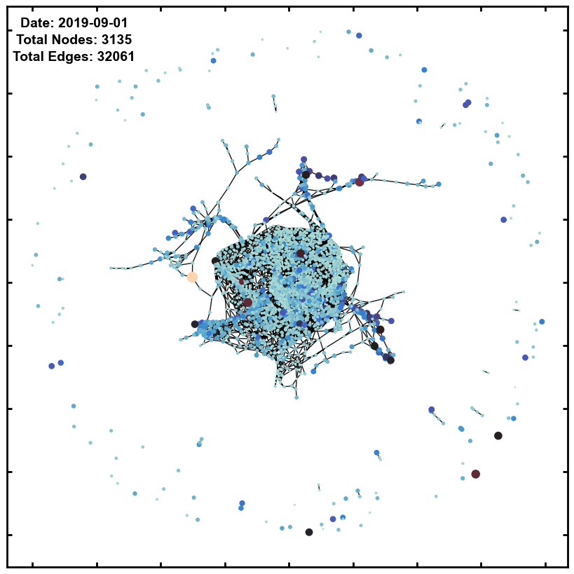
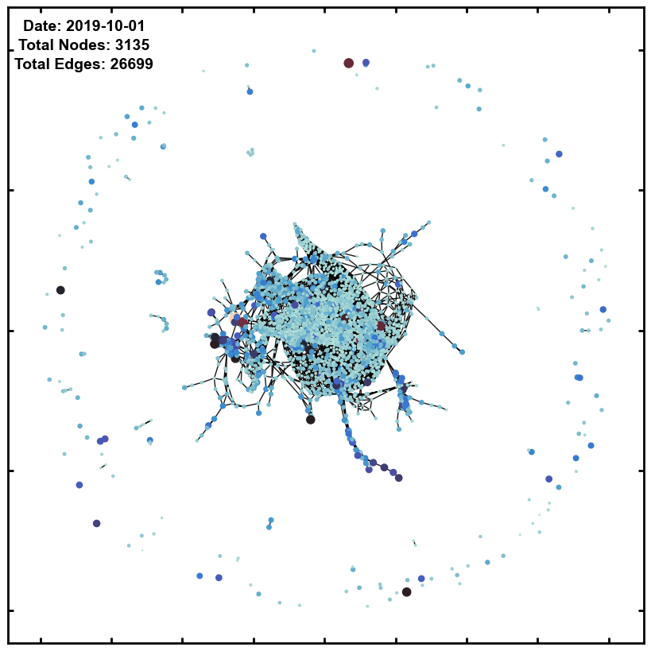
Graph Data Preparation and Tableau Visualizations
Tabular Data to Graph Data: (cont.) – Graph Embedding Visualizations
Static Graph → Dynamic Graph
25% total number of Edges are dropped randomly in each time snapshot.

Slide 31
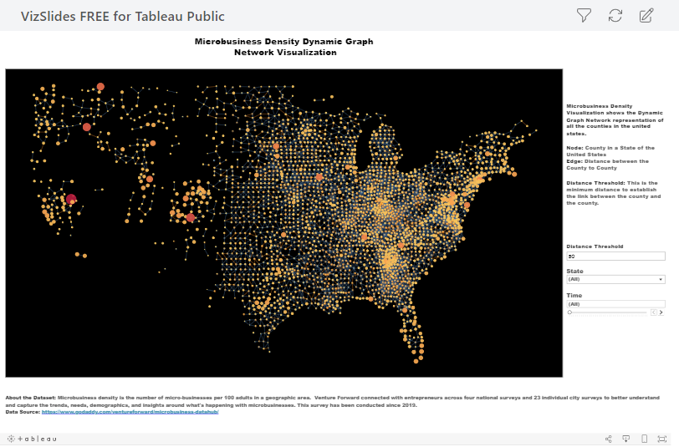
Graph Data Preparation and Tableau Visualizations
Tabular Data to Graph Data: (cont.) – Graph On Map Tableau Visualizations

Slide 32
Validation of Framework on Benchmark Datasets
The effectiveness of the ATGCN is very critical for current work.
Challenges:
Propose the valid Temporal Graph Convolutional Network Framework
Validation of the Proposed Framework with standard datasets
Solution:
Compare the Various Models and decide on the Framework for current research.

Slide 33
Validation of Framework on Benchmark Datasets
Datasets:
SZ – Taxi Dataset
Taxi trajectory of Shenzhen from Jan. 1 to Jan. 31, 2015
156 significant roads in the Luohu District
Traffic Speed is the Variable
Los-loop Dataset
This dataset was collected on the highway of Los Angeles County in real-time by loop detectors.
207 sensors and their traffic speed from Mar.1 to Mar.7, 2012.
J. Zhu, Y. Song, L. Zhao, and H. Li, “A3t-gcn: Attention temporal graph convolutional network for traffic forecasting,” 2020.

Slide 34
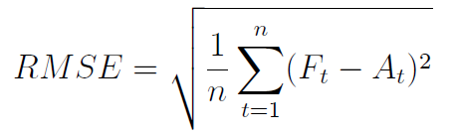
Validation of Framework on Benchmark Datasets
Models and Metric:
Statistical Methods, ML, and DL Models:
Historical Average, ARIMA, SVM, GCN, GRU
Graph-Based Models:
Temporal Graph Convolutional Network ( TGCN) and Attention-based Temporal Graph Convolutional Network (A3TGCN)
Metric:
Root Mean Squared Error (RMSE)
where n is the number of observations in the test set,
Ft is the forecast value for time t,
At is the actual value for time t.

Slide 35
Validation of Framework on Benchmark Datasets
Cumulative Sum of RMSE Values
Cumulative Sum of RMSE Values
SZ- taxi 15min Forecasting Performance comparison
Los-loop 15min Forecasting Performance comparison
Attention-based Temporal Graph Convolutional Networks performance is better compared to other models. Hence its chosen to validate the current hypothesis.
J. Zhu, Y. Song, L. Zhao, and H. Li, “A3t-gcn: Attention temporal graph convolutional network for traffic forecasting,” 2020.

Slide 36
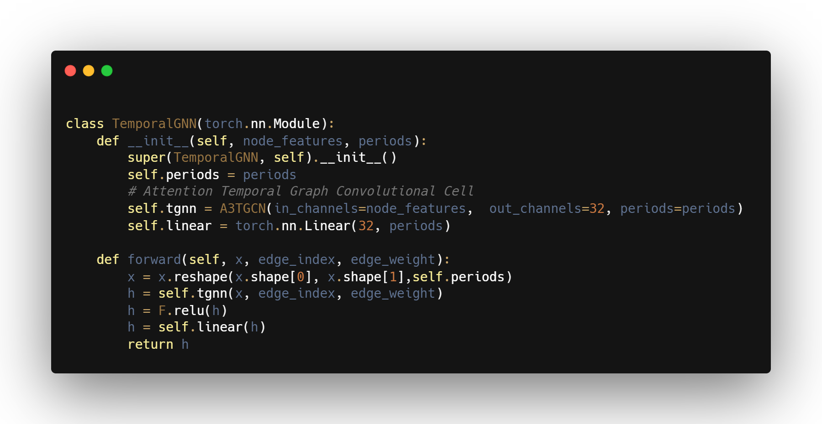
Attention Based Temporal Graph Convolutional Network Node level predictions
Model Framework
Graph Input
A3TCN Cell
Relu Activation
Linear Layer
Outputs

Slide 37
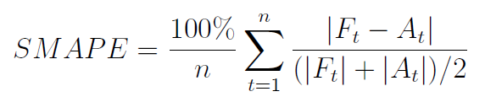
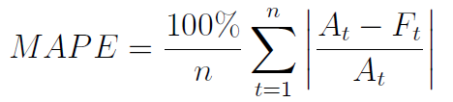
Attention Based Temporal Graph Convolutional Network Node level predictions
Model Framework (Cont.)
Time lags: 5-time lags
Train, test split ratio: 0.9
Based on this, Train data have 31 Temporal Graphs; Test data have 3 temporal Graphs.
Data: Only To MISSOURI state Level
Optimizer: Adam Optimizer
Learning rate: 0.001
Cost Function:
Symmetric Mean Absolute Percentage Error (SMAPE)
Metrics: SMAPE, MAPE, RMSE
where n is the number of observations in the test set,
Ft is the forecast value for time t,
At is the actual value for time t.

Slide 38
Attention Based Temporal Graph Convolutional Network Node level predictions
Static Graph-based Forecasting
Temporal Features: Only Dynamic Node features
Temporal + Census Features:
Both Dynamic and Static Node features
Comparing the overall costs of the last 3 months’ predictions, a model with all the features outperformed Temporal features.
Cumulative Sum of cost values
Static Graph Time Snapshot-Based
A3-TGCN Forecasting Testing Performance

Slide 39
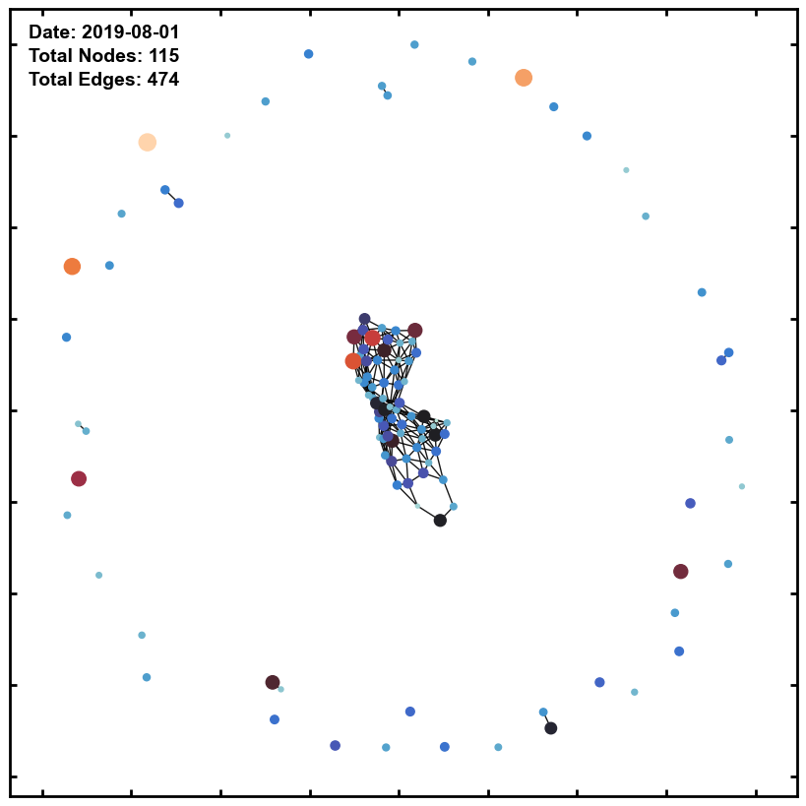
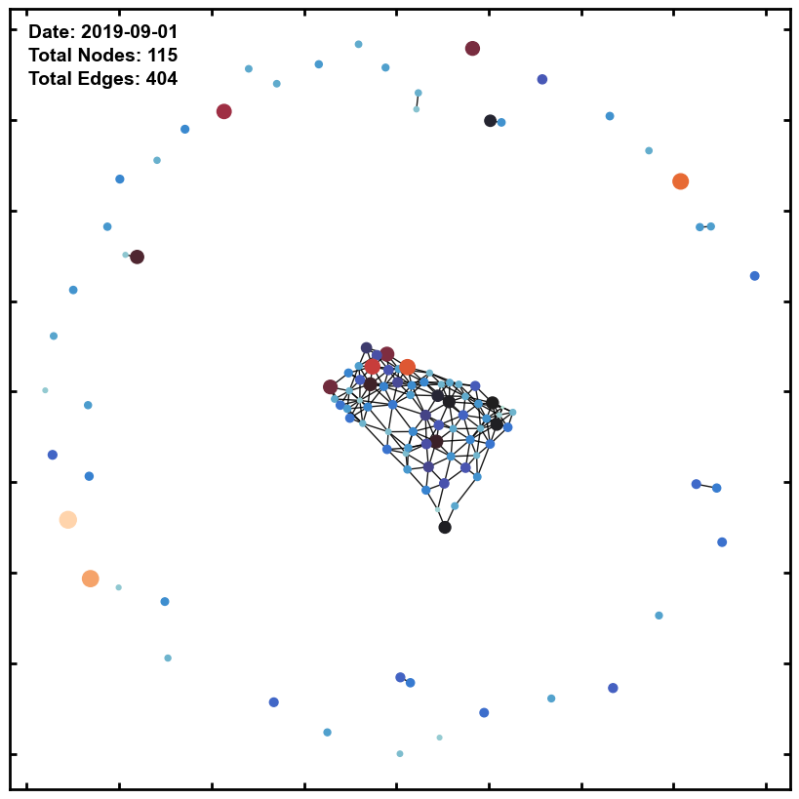
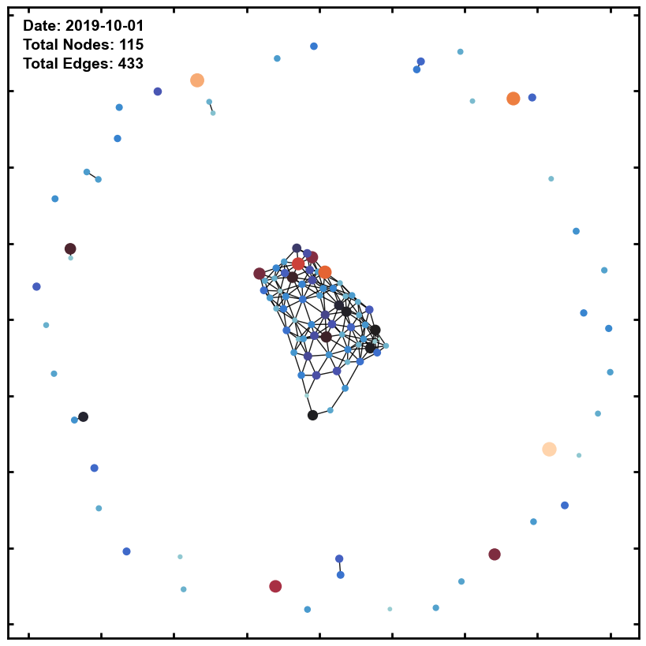
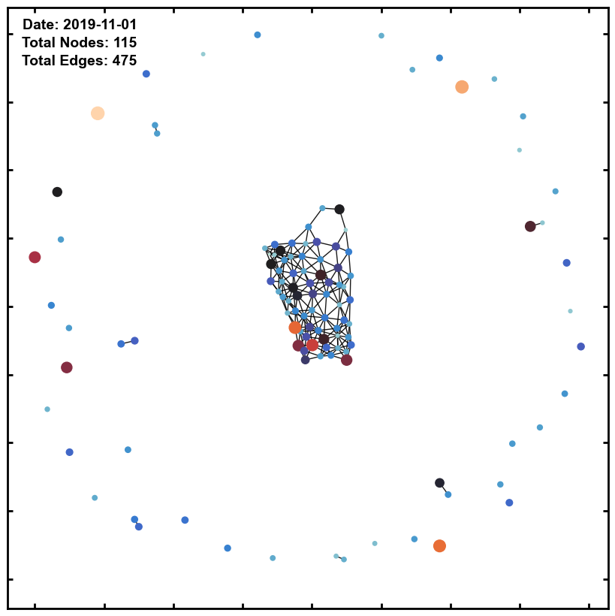
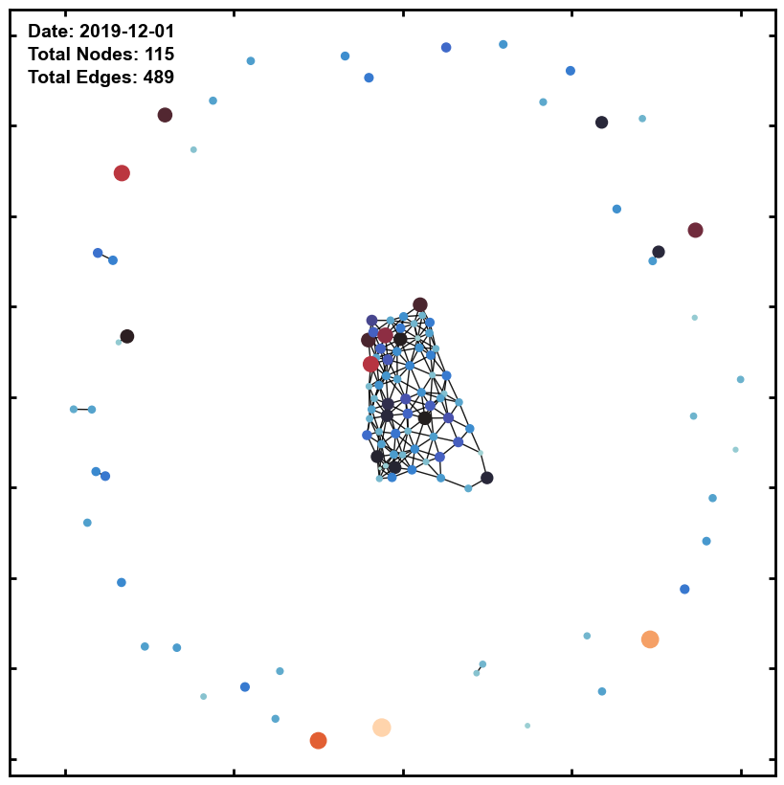
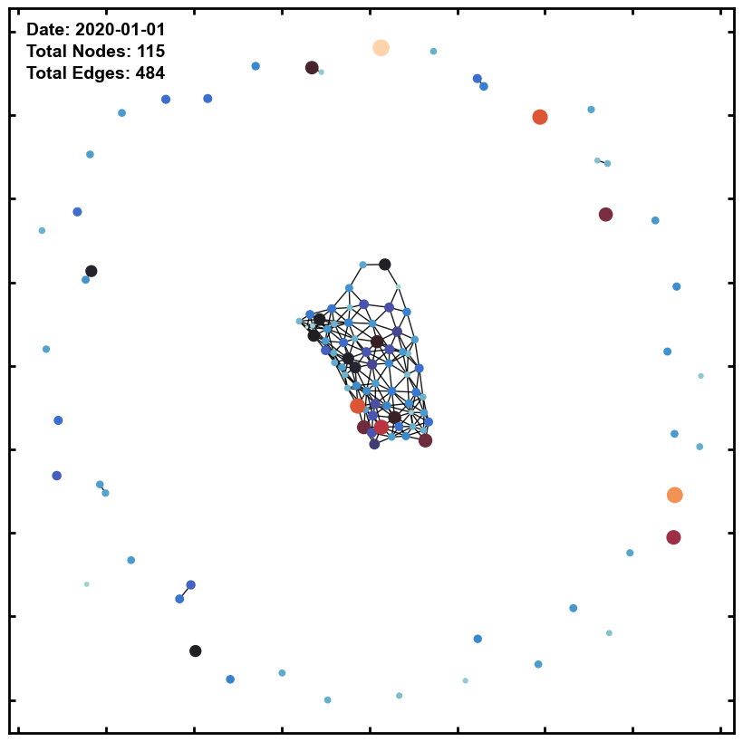
Attention Based Temporal Graph Convolutional Network Node level predictions
Dynamic Graph-based Forecasting

Slide 40
Attention Based Temporal Graph Convolutional Network Node level predictions
Dynamic Graph-based Forecasting
Temporal Features: Only Dynamic Node features
Temporal + Census Features:
Both Dynamic and Static Node features
Comparing the overall costs of the last 3 months’ predictions, a model with all the features outperformed Temporal features.
Cumulative Sum of cost values
Dynamic Graph Time Snapshot-Based A3-TGCN Forecasting Testing Performance

Slide 41
Attention Based Temporal Graph Convolutional Network Node level predictions
Static VS Dynamic Graph-based Forecasting
The dropout in the dynamic graph gave a better performance.
Cumulative Sum of cost values
Dynamic Graph Time Snapshot-Based A3-TGCN Forecasting Testing Performance

Slide 42
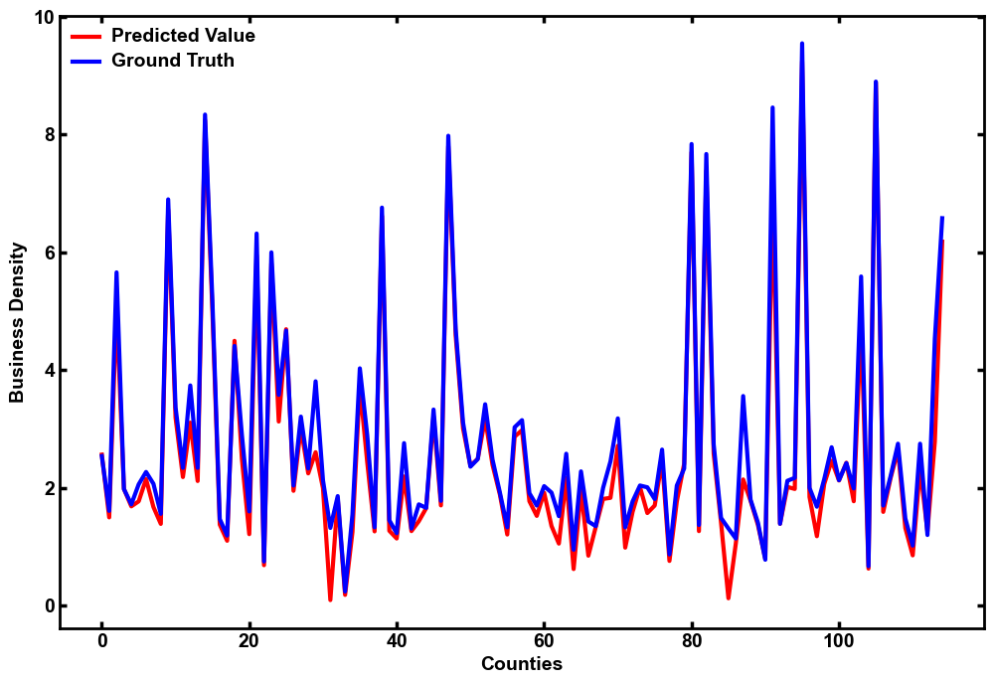
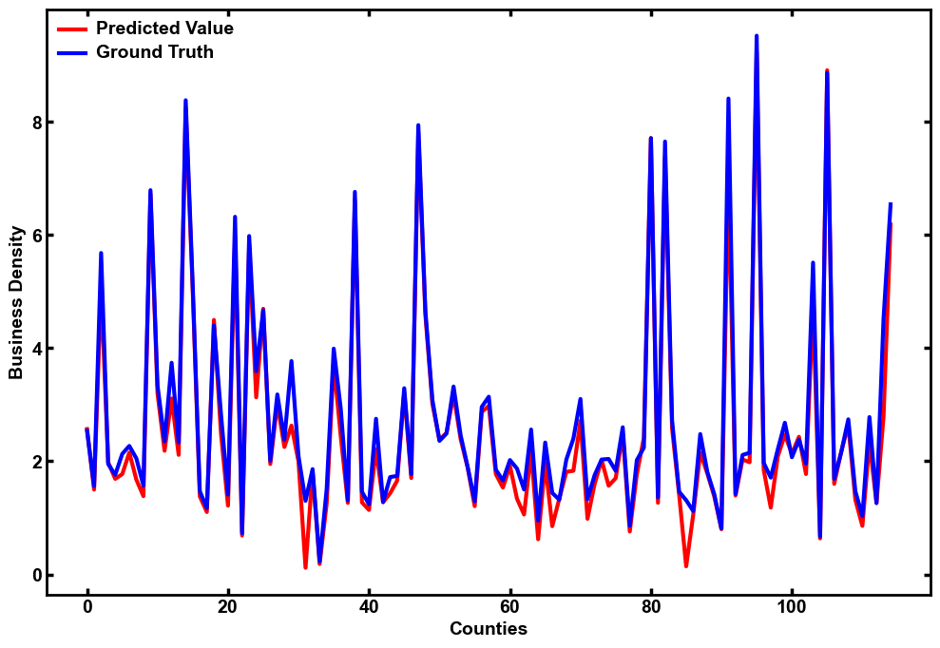
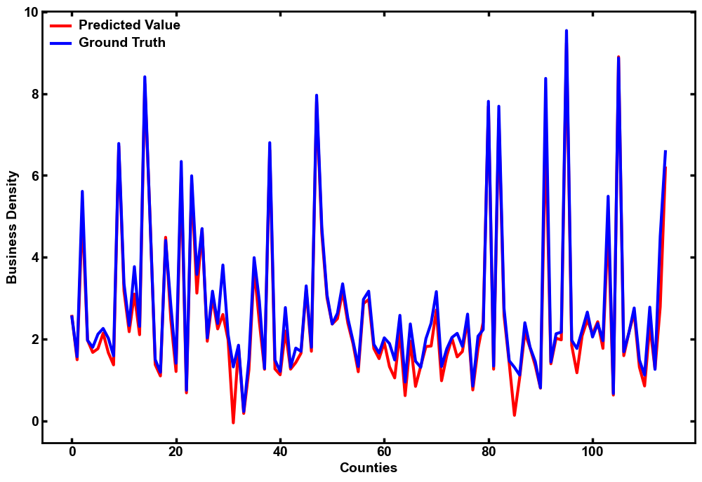
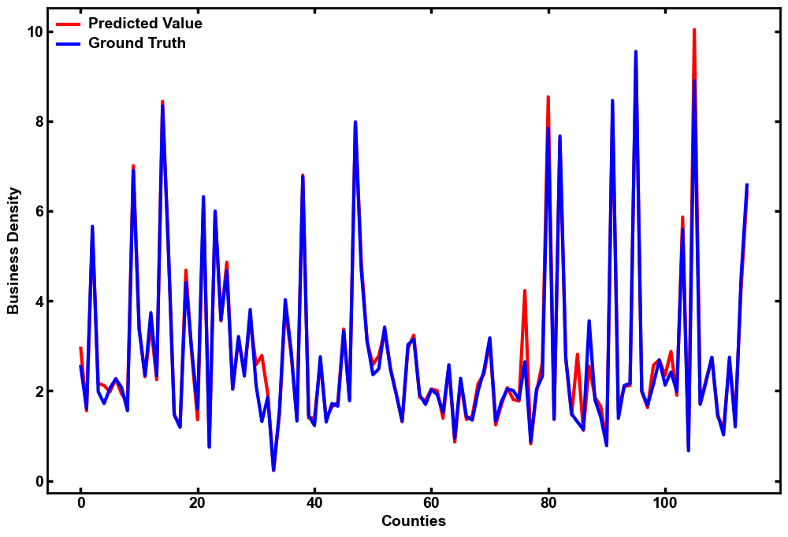
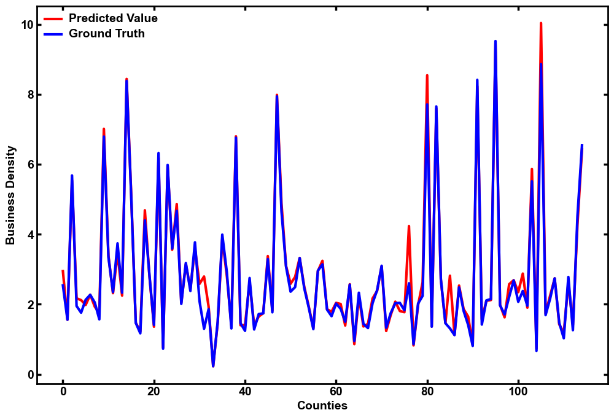

Attention Based Temporal Graph Convolutional Network Node level predictions
Static VS Dynamic Graph-based Forecasting (cont.)
2022-08
2022-09
2022-10
Static Graph (All Features)
Dynamic Graph (All Features)

Slide 43
Statistical Methods & Machine learning Model-based Time series predictions
Models
Baseline Methods:
Naïve Method
Seasonal Naïve Method
Monthly Mean Naïve Method
Statistical & Machine Learning Models:
SARIMA
Holt-Winters Exponential Smoothing
Linear regression
Random Forest
Support Vector Machines

Slide 44
Statistical Methods & Machine learning Model-based Time series predictions
Averaged Node level Time-series Forecasting
115 Counties are present in Missouri, → 115 Node will be present in the Graph
To understand the macro behavior → Average of the time series is performed across the nodes.

Slide 45
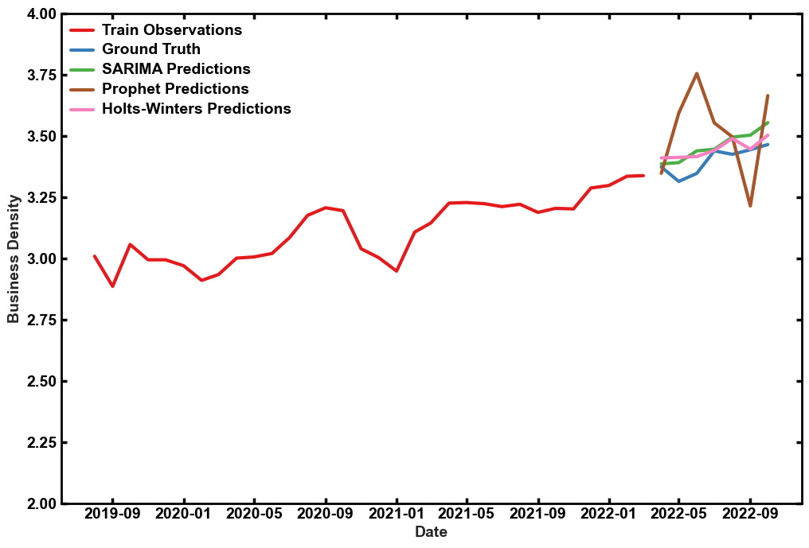
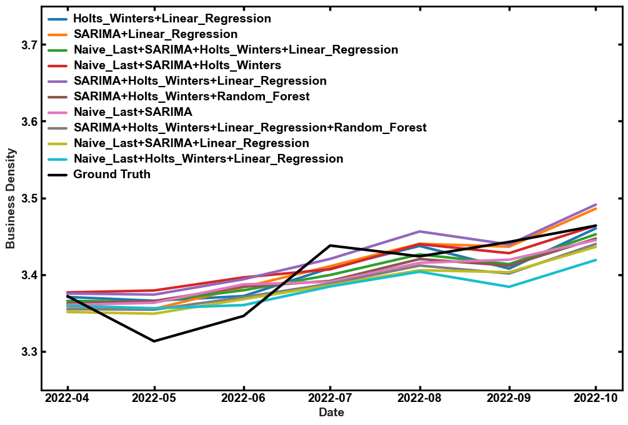
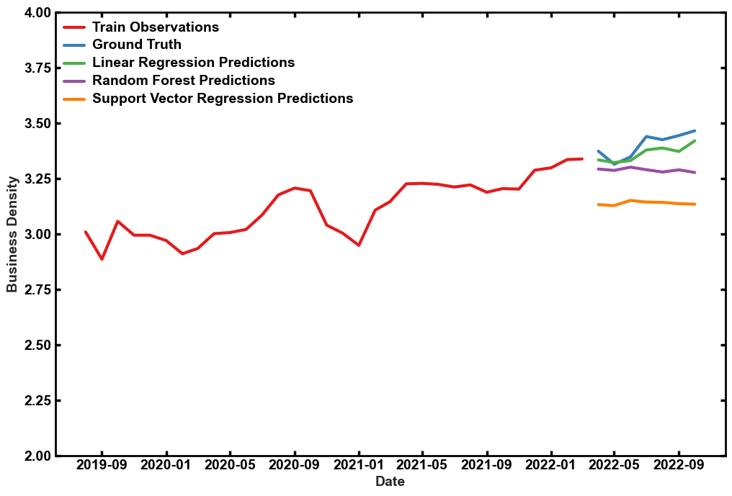
Statistical Methods & Machine learning Model-based Time series predictions
Averaged Node level Time-series Forecasting (cont.)
Naïve Baseline Forecasting
Machine learning Baseline Forecasting
Ensemble Combinations based on predictions

Slide 46
Statistical Methods & Machine learning Model-based Time series predictions
Averaged Node level Time-series Forecasting (cont.)
The Statistical Methods without any spatial dependency outperformed the Machine learning models, as per the literature.
Cumulative Sum of cost values

Slide 47
Statistical Methods & Machine learning Model-based Time series predictions
Individual Node level Time-series Forecasting
115 Counties are present in Missouri, → 115 Node will be present in the Graph
115 different time series are trained and tested with statistical and machine learning methods.
Cumulative Sum of the test data was captured, which could be used to benchmark the A3TGCN Framework.

Slide 48
Statistical Methods & Machine learning Model-based Time series predictions
Individual Node level Time-series Forecasting(cont.)
The Statistical Methods without any spatial dependency outperformed the Machine learning models, as per the literature.
Cumulative Sum of cost values

Slide 49
Comparing the performance of traditional methods with Graph-based forecasting.
A3TGCN Outperformed other methods, and results are in line with the Validation with benchmark datasets.
Cumulative Sum of cost values

Slide 50
Agenda
1. Introduction
Background
Challenges and Contributions
2. Literature Review and Previous Work
Why TGCN?
Model Framework
Nature of Graph
3. Software and Hardware Stack and Tools
4. Proposed Approaches and Results
Graph Data Preparation and Tableau Visualizations
Validation of Framework on Benchmark Datasets
Attention Based Temporal Graph Convolutional Network Node level predictions
Statistical Methods & Machine learning Model-based Time series predictions
Comparison of A3TGCN and Other Methods
4. Conclusions

Slide 51

Conclusions and Future Work
Proposed a new framework for attention-based temporal graph convolutional networks for time series forecasting.
A3TGCN model effectively captures interdependencies in time series networks, providing more accurate predictions than traditional methods and machine learning models.
Attention mechanism in our model allows better interpretation of relationships between time series data, providing insights into underlying dynamics.
Our proposed framework contributes to the growing field of deep learning approaches for time series forecasting and provides a promising direction for future research.
Model can be applied to various domains, such as finance, healthcare, and energy, to provide accurate and interpretable predictions.

Slide 52
References
1. Godaddy.com, “Microbusiness density data hub,” Available at: https://www.
godaddy.com/ventureforward/microbusiness-datahub/, 2022, accessed Day Month
Year.
2. R. Adhikari and R. K. Agrawal, “An introductory study on time series modeling and
forecasting,” ArXiv Preprint arXiv:1302.6613, 2013.
3. B. Yu, H. Yin, and Z. Zhu, “Spatio-temporal graph convolutional networks: A deep
learning framework for traffic forecasting,” ArXiv Preprint arXiv:1709.04875, 2017.
4. M. S. Ahmed and A. R. Cook, Analysis of Freeway Traffic Time-series Data by
Using Box-Jenkins Techniques, 1979, no. 722.
5. J. Zhu, Y. Song, L. Zhao, and H. Li, “A3t-gcn: Attention temporal graph convolutional
network for traffic forecasting,” 2020.

Slide 53


Thank You
Bhuvan Chennoju
Bhuvankumarchennoju@gamil.com
https://bhuvan454.github.io/

